Slide 1
CASE STUDY 1 – MSDS 6306
Jonathan Flores, Melissa Luzardo and Randy Park

Slide 2
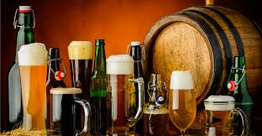
“New Brewery Inc” Requests brewery Marketing evaluation
Request:
“New Brewery Inc” commissioned their marketing department with the evaluation of the US craft beer and brewery market for the launching of their new product “Better Beer”.
Data Sources and Assumptions:
To perform this study, the marketing department data scientist relied on the “Beers” and “Breweries” datasets provided by their marketing research counterpart and focus on specific points of interests delineated by the companies upper management.

Slide 3
Brewery and beer market evaluation
Extracted from “Brewery” and “Beer” datasets

Slide 4
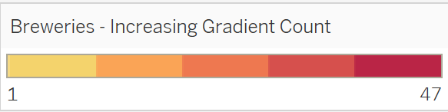
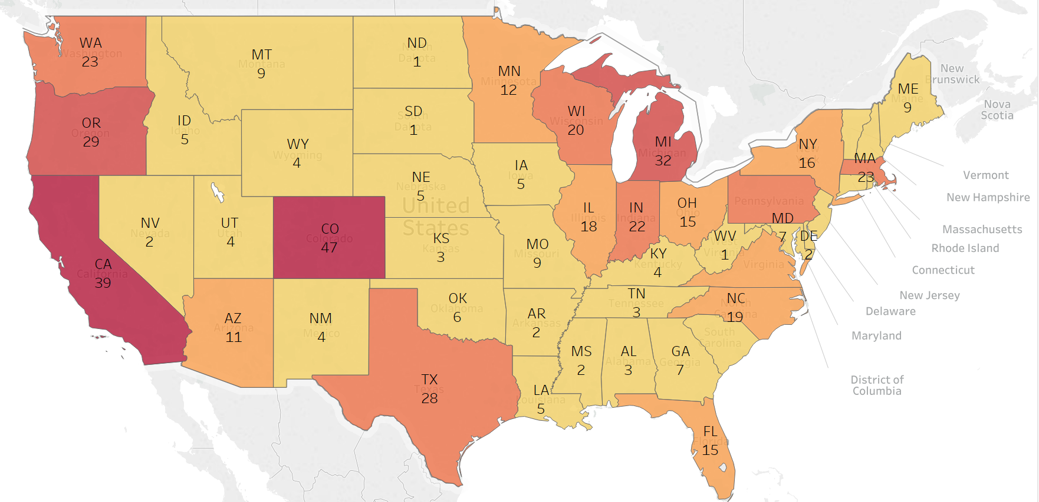
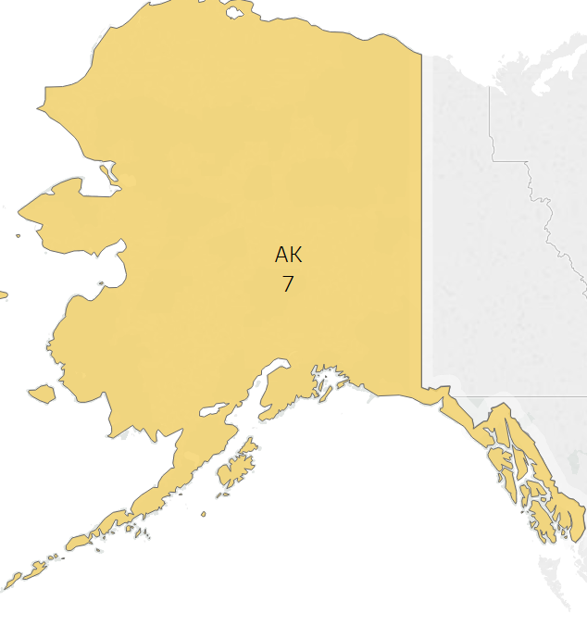
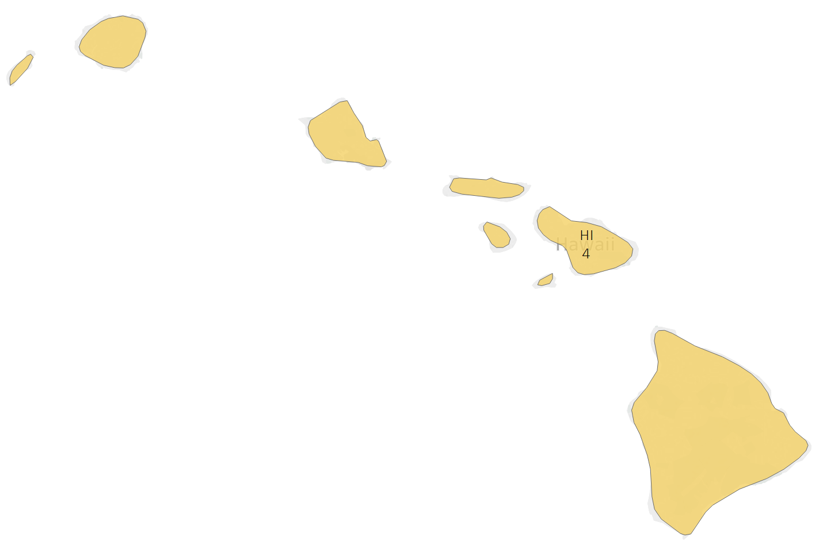
There are 558 breweries in the United States

Slide 5
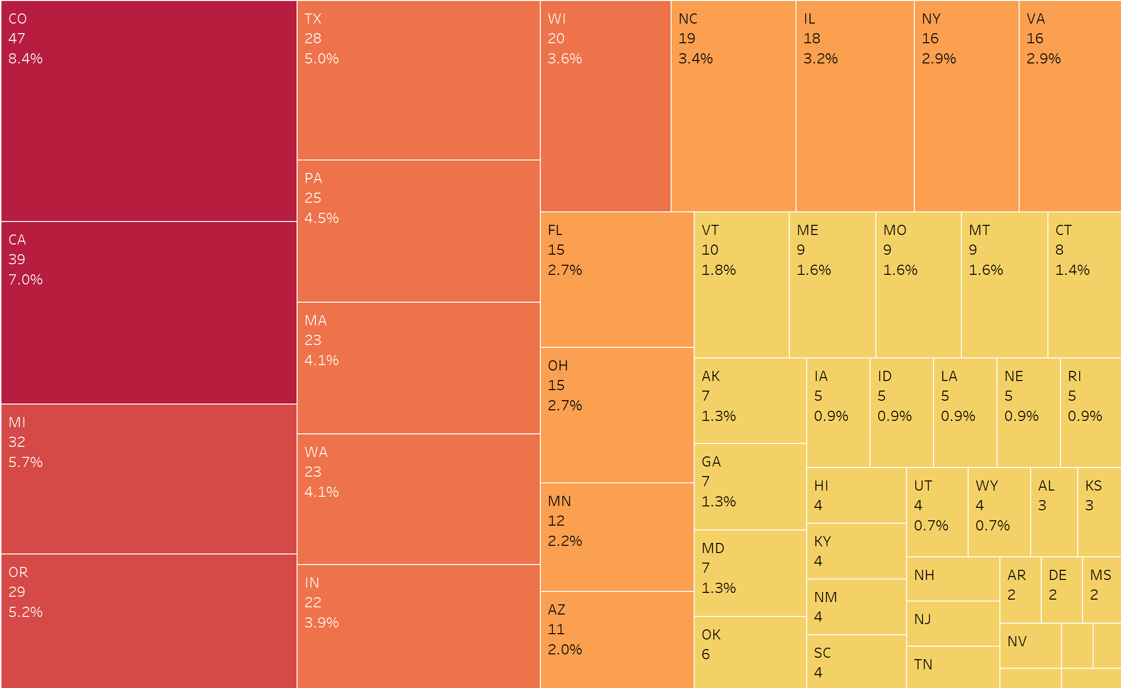
Distribution of breweries in the US
Insights:
The following 10 states make 50% of the breweries in the US
CO, CA, MI, OR, TX,PA, WA, MA, IN and WI
The following 7 states make 20% of the breweries in the US
NC, IL, VA, NY, FL, OH and MN
The other 30 and DC make up the remaining 30%
Notes:
50% of the states (10) - Colorado, California, Michigan, Oregon, Pennsylvania, Washington, Massachussetts, Indiana and Wisconsin
20% of the states (7) – North Carolina, Illinois, Virginia, New York, Florida, Ohio and Minnesota

Slide 6
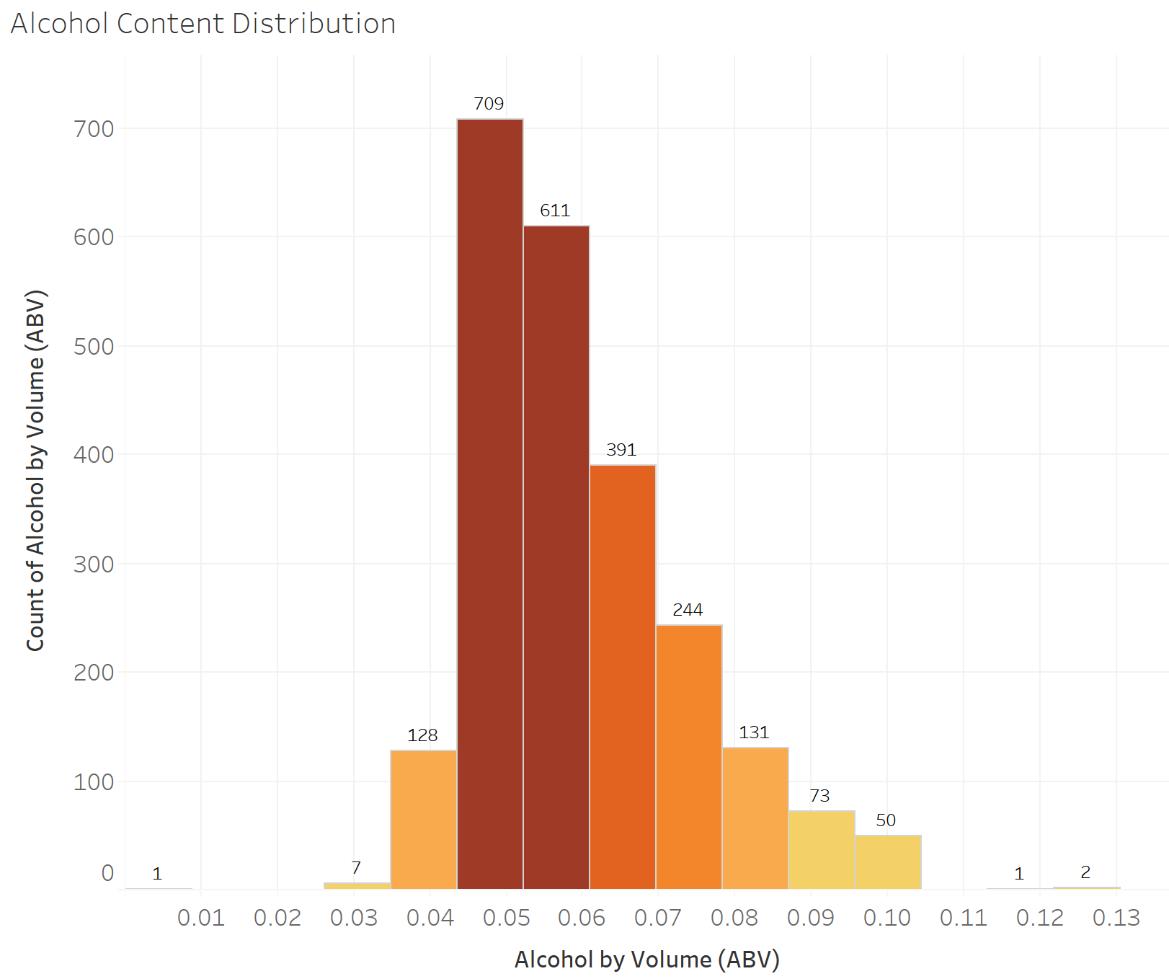
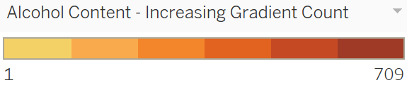
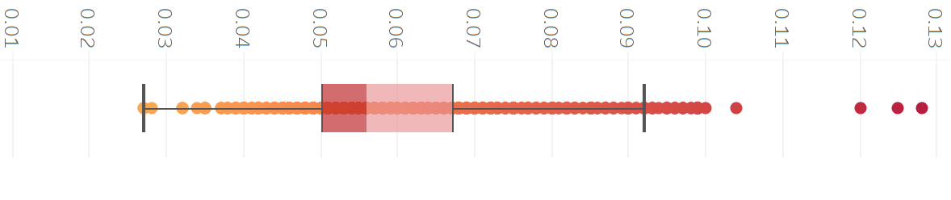
The alcohol by volume (ABV) summary stats
CO has the beer with the highest Alcohol by Volume beer - 0.128
Statistics Descriptions | Stats
No. of Observations (excluding null values) | 2,348
Average ABV | 0.0597
Median ABV | 0.056
Max Value | 0.128
Min Value | 0.001
Upper Whisker – Excluding Outliers | 0.092
Lower Whisker – Excluding Outliers | 0.027
Upper Hinge | 0.067
Lower Hinge | 0.05
*62 null values in the ABV excluded in this analysis

Slide 7
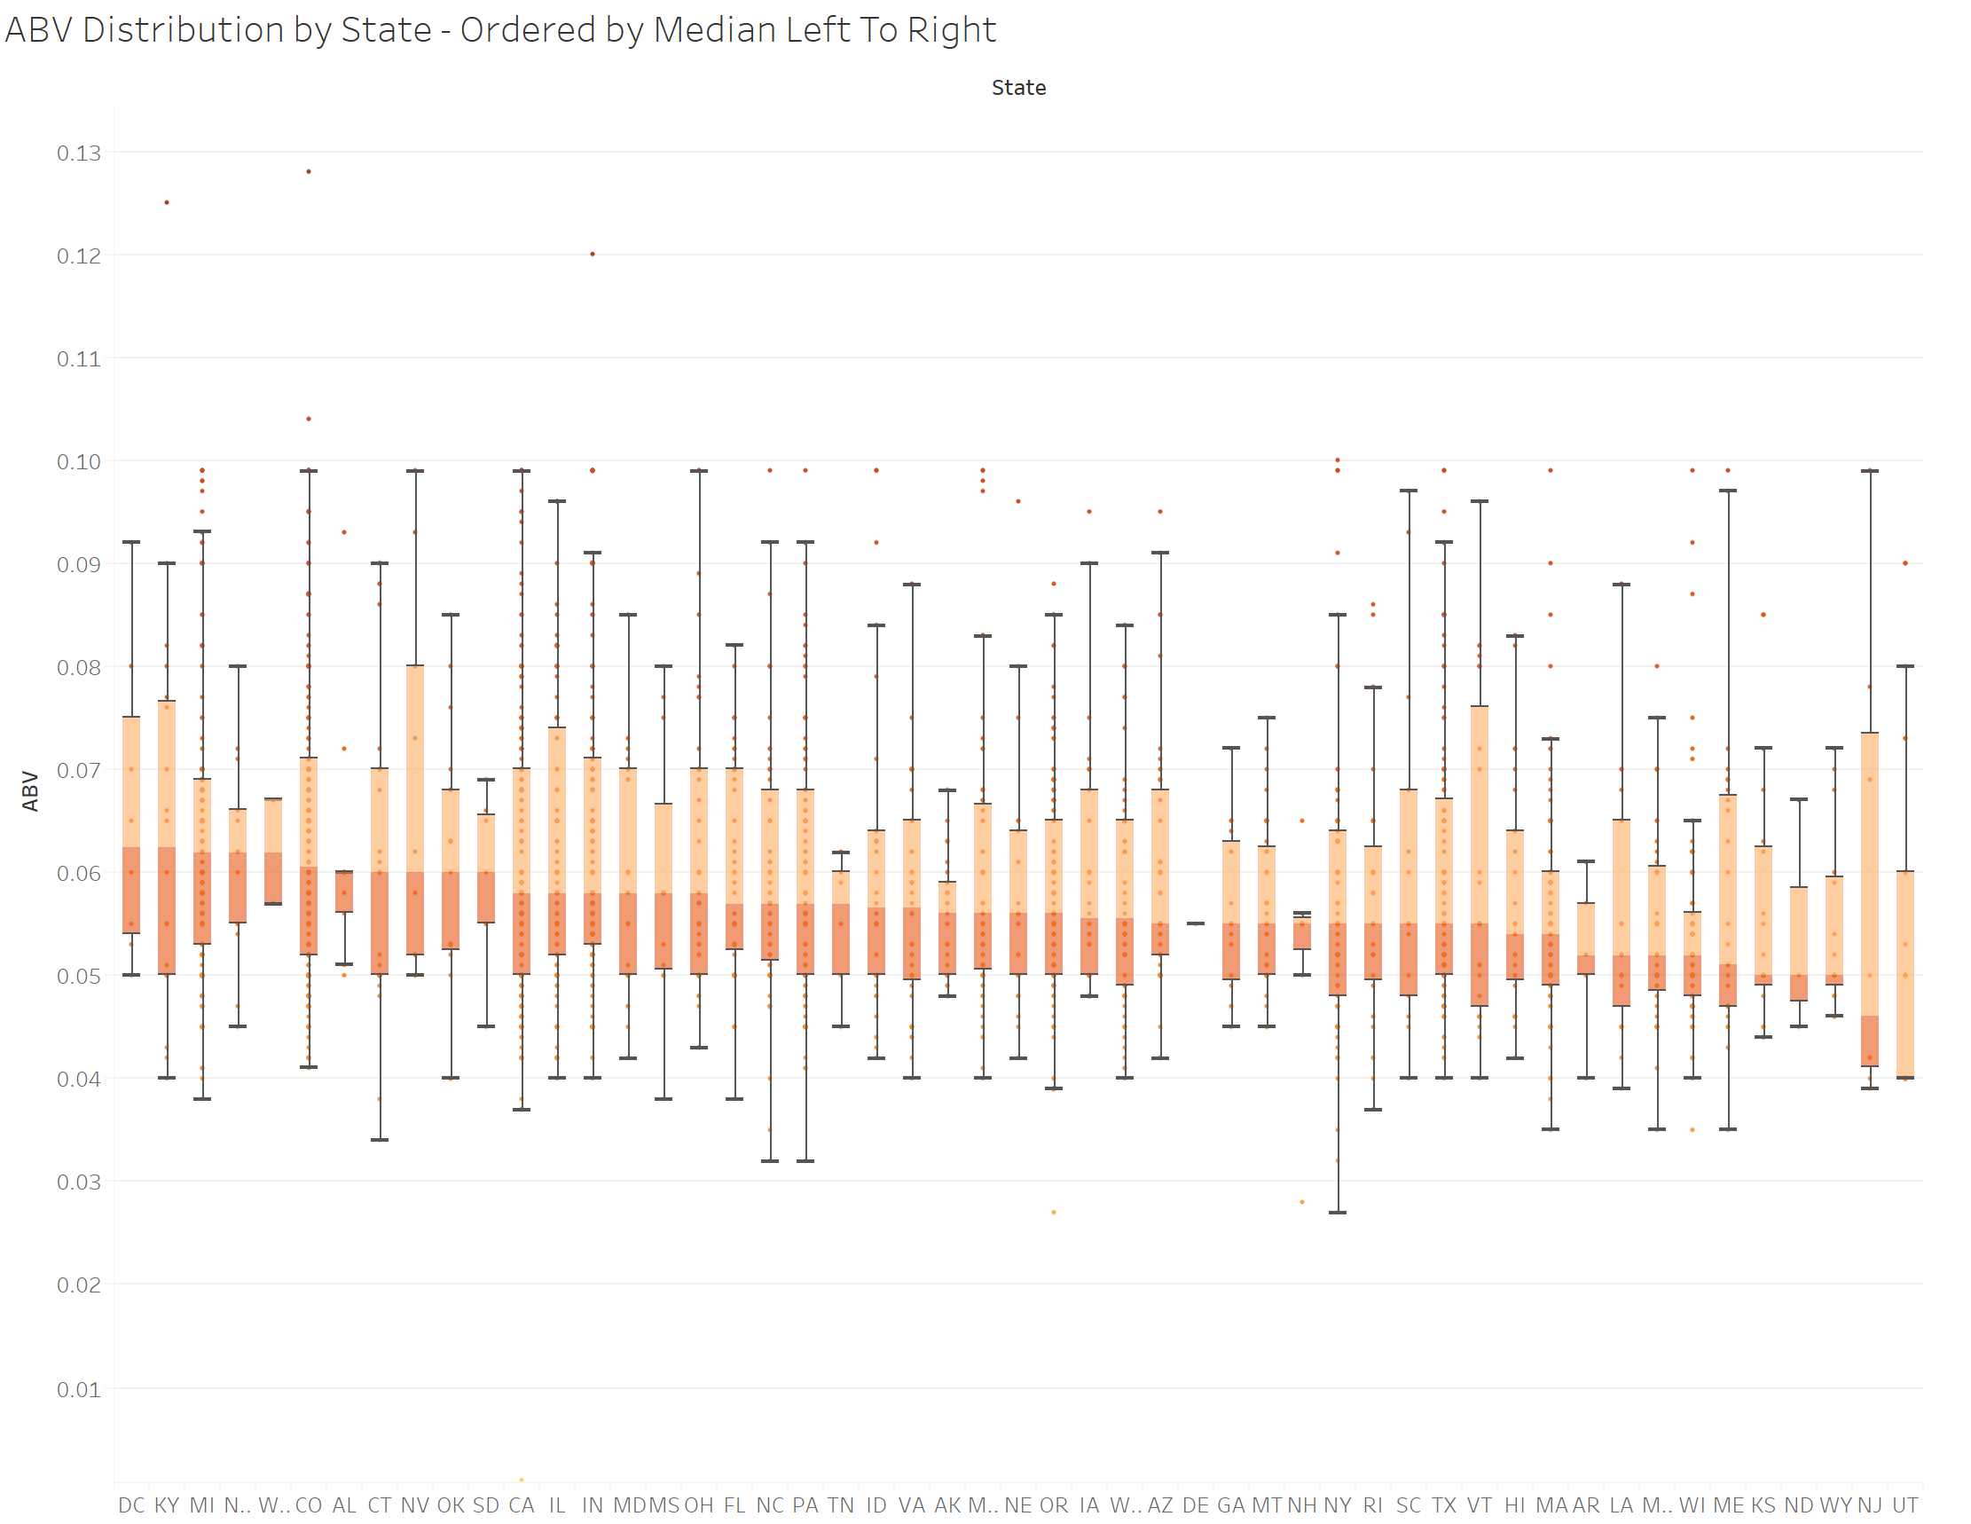
MEDIAN alcohol distribution (ABV) by state
State | Median ABV
UT | 0.04
NJ | 0.046
KS | 0.05
ND | 0.05
WY | 0.05
ME | 0.051
AR | 0.052
LA | 0.052
MO | 0.052
WI | 0.052
HI | 0.054
MA | 0.054
AZ | 0.055
DE | 0.055
GA | 0.055
MT | 0.055
NH | 0.055
NY | 0.055
RI | 0.055
SC | 0.055
TX | 0.055
VT | 0.055
IA | 0.0555
WA | 0.0555
AK | 0.056
MN | 0.056
NE | 0.056
OR | 0.056
ID | 0.0565
VA | 0.0565
TN | 0.057
FL | 0.057
NC | 0.057
PA | 0.057
CA | 0.058
IL | 0.058
IN | 0.058
MD | 0.058
MS | 0.058
OH | 0.058
AL | 0.06
CT | 0.06
NV | 0.06
OK | 0.06
SD | 0.06
CO | 0.0605
MI | 0.062
NM | 0.062
WV | 0.062
DC | 0.0625
KY | 0.0625
Median Alcohol by State in Descending Order

Slide 8
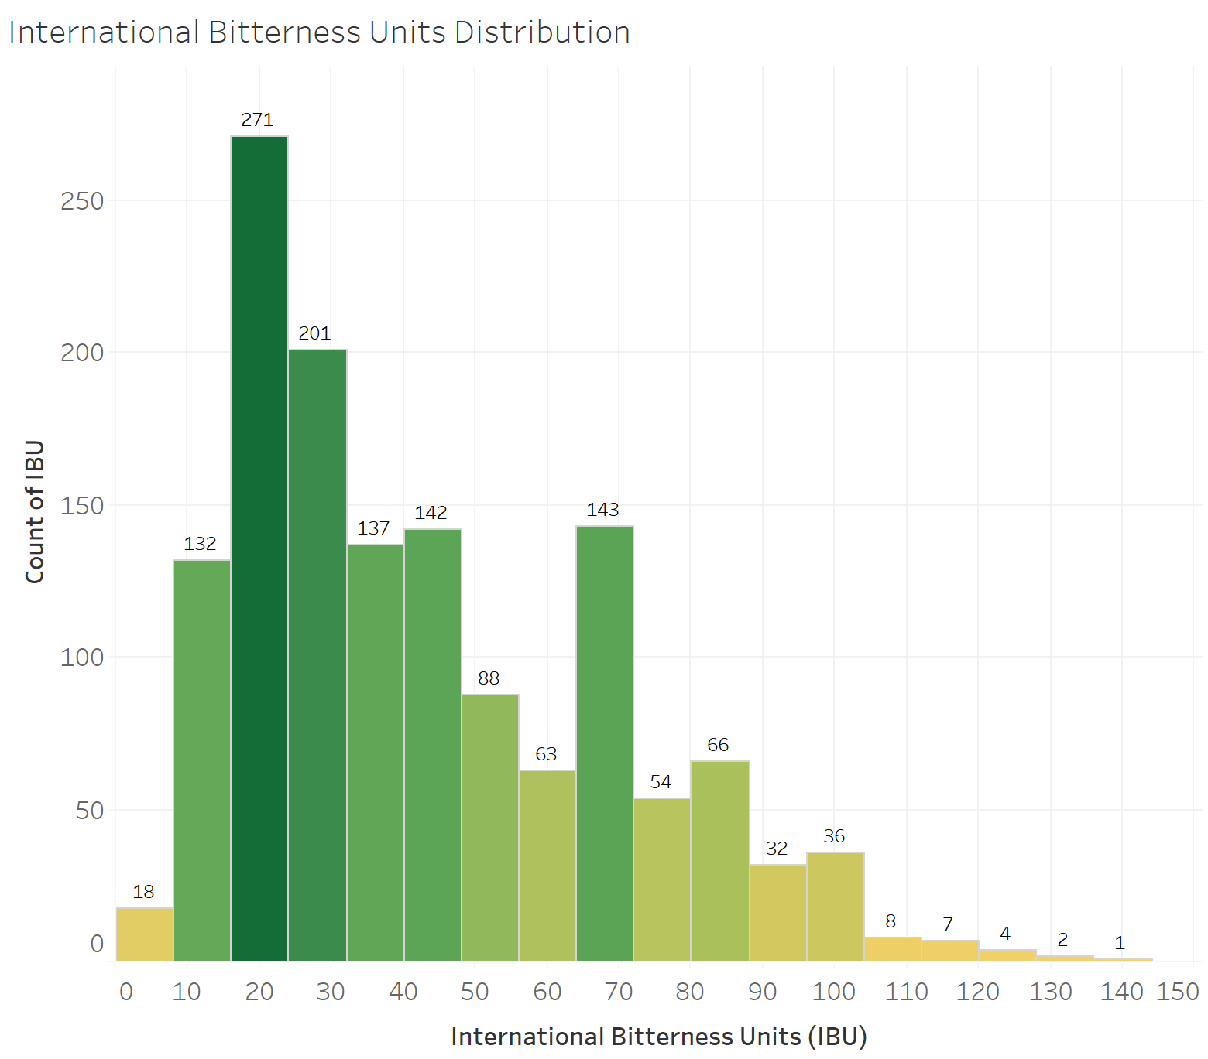
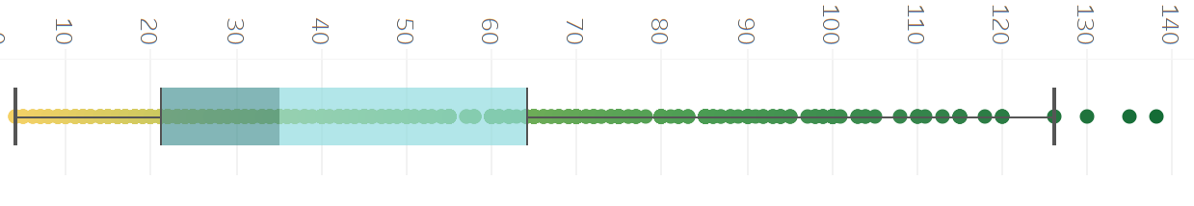
international bitterness units (IBU) summary stats
OR has the beer with the highest IBU - 138
Statistics Descriptions | Stats
No. of Observations (excluding null values) | 1,405
Average ABV | 42.71
Median ABV | 35
Max Value | 138
Min Value | 4
Upper Whisker – Excluding Outliers | 126
Lower Whisker – Excluding Outliers | 4
Upper Hinge | 64
Lower Hinge | 21
* 111 null values in the IBU excluded in this analysis

Slide 9
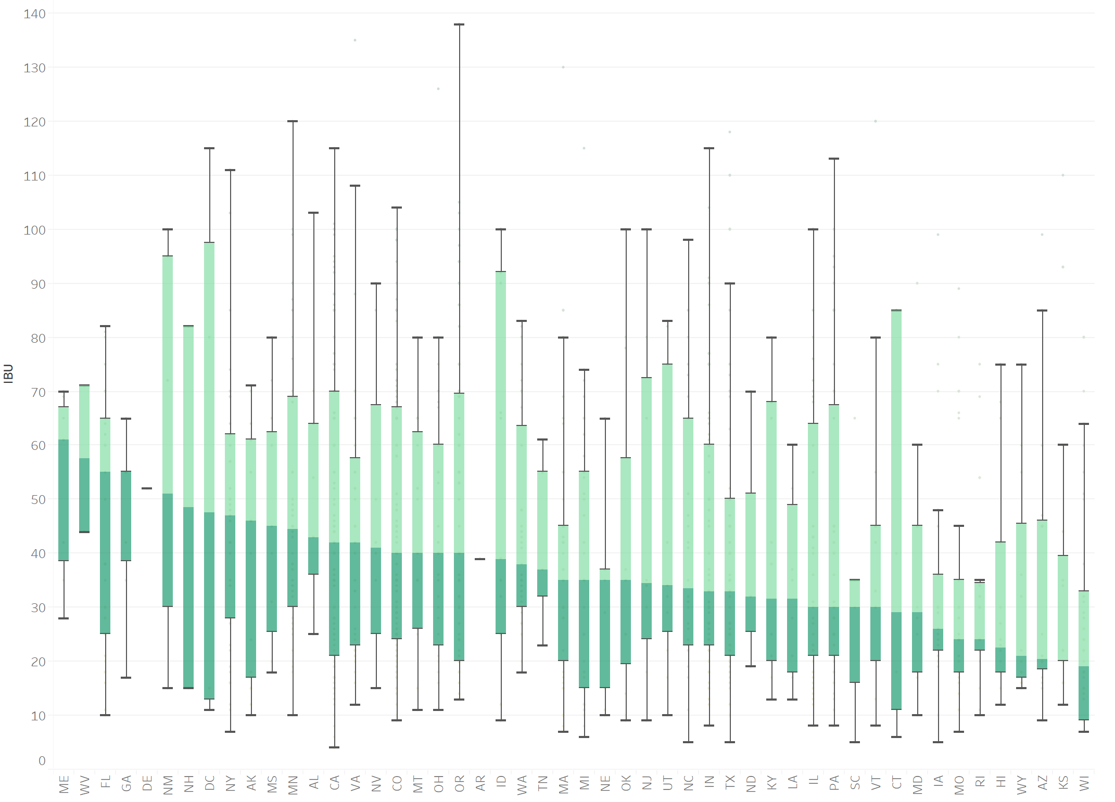
MEDIAN international bitterness (IBU) by state
IBU Distribution by State – Ordered by Median in Descending Order. Left to Right
State | Median IBU
ME | 61
WV | 57.5
FL | 55
GA | 55
DE | 52
NM | 51
NH | 48.5
DC | 47.5
NY | 47
AK | 46
MS | 45
MN | 44.5
AL | 43
CA | 42
VA | 42
NV | 41
CO | 40
MT | 40
OH | 40
OR | 40
AR | 39
Median Alcohol by State in Descending Order
ID | 39
WA | 38
TN | 37
MA | 35
MI | 35
NE | 35
OK | 35
NJ | 34.5
UT | 34
NC | 33.5
IN | 33
TX | 33
ND | 32
KY | 31.5
LA | 31.5
IL | 30
PA | 30
SC | 30
VT | 30
CT | 29
MD | 29
IA | 26
MO | 24
RI | 24
HI | 22.5
WY | 21
AZ | 20.5
KS | 20
WI | 19
SD

Slide 10
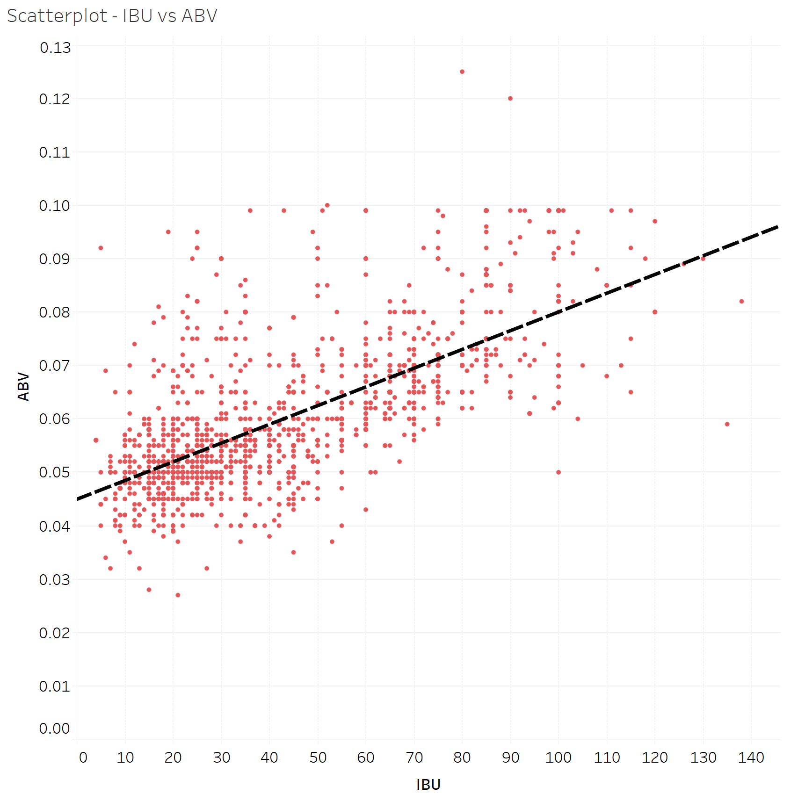
IBU vs ABV - positive direct relationship
There is a positive direct relationship between IBU and ABV. The R-squared of 0.45 indicates there is a moderate, not high, strength between these two variables. The simple linear regression formula is as follow:
R-Squared: 0.45
Coefficients
Term | Value
IBU (Y) | 0.0003508
Intercept (X) | 0.0449303
Meaning, the intercept is where x meets the value of y. For every 0.045 units of x, y moves 0.00035

Slide 11
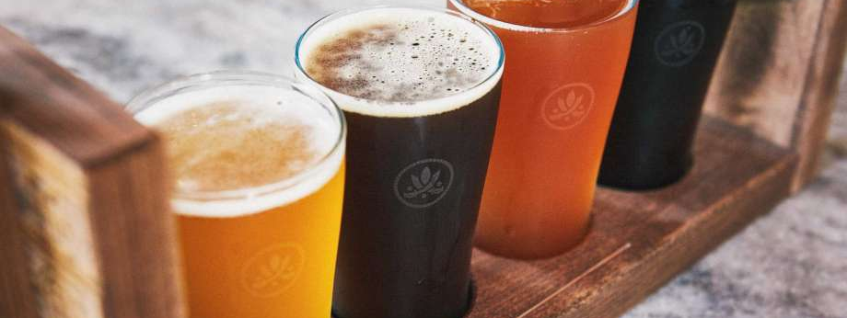
Case Study 1 - Repository URL: https://github.com/jfzjonathan/casestudy1
Team Members:
Jonathan Flores, Melissa Luzardo and Randy Park

